Slide 1


Logo of Polimi and NearLAB
Logo of your other affilitations (if you have them)
Implementation and Assessment of an Augmented Surgical Training Curriculum
with a daVinci robot: an experimental study
Candidate: Alberto Rota
Advisor: Prof. Elena De Momi, PhD
Co-Advisor: Ke Fan
Master of Science in Biomedical Engineering – Ingegneria Biomedica
December 20th 2022
Academic Year 2021-2022

Slide 2
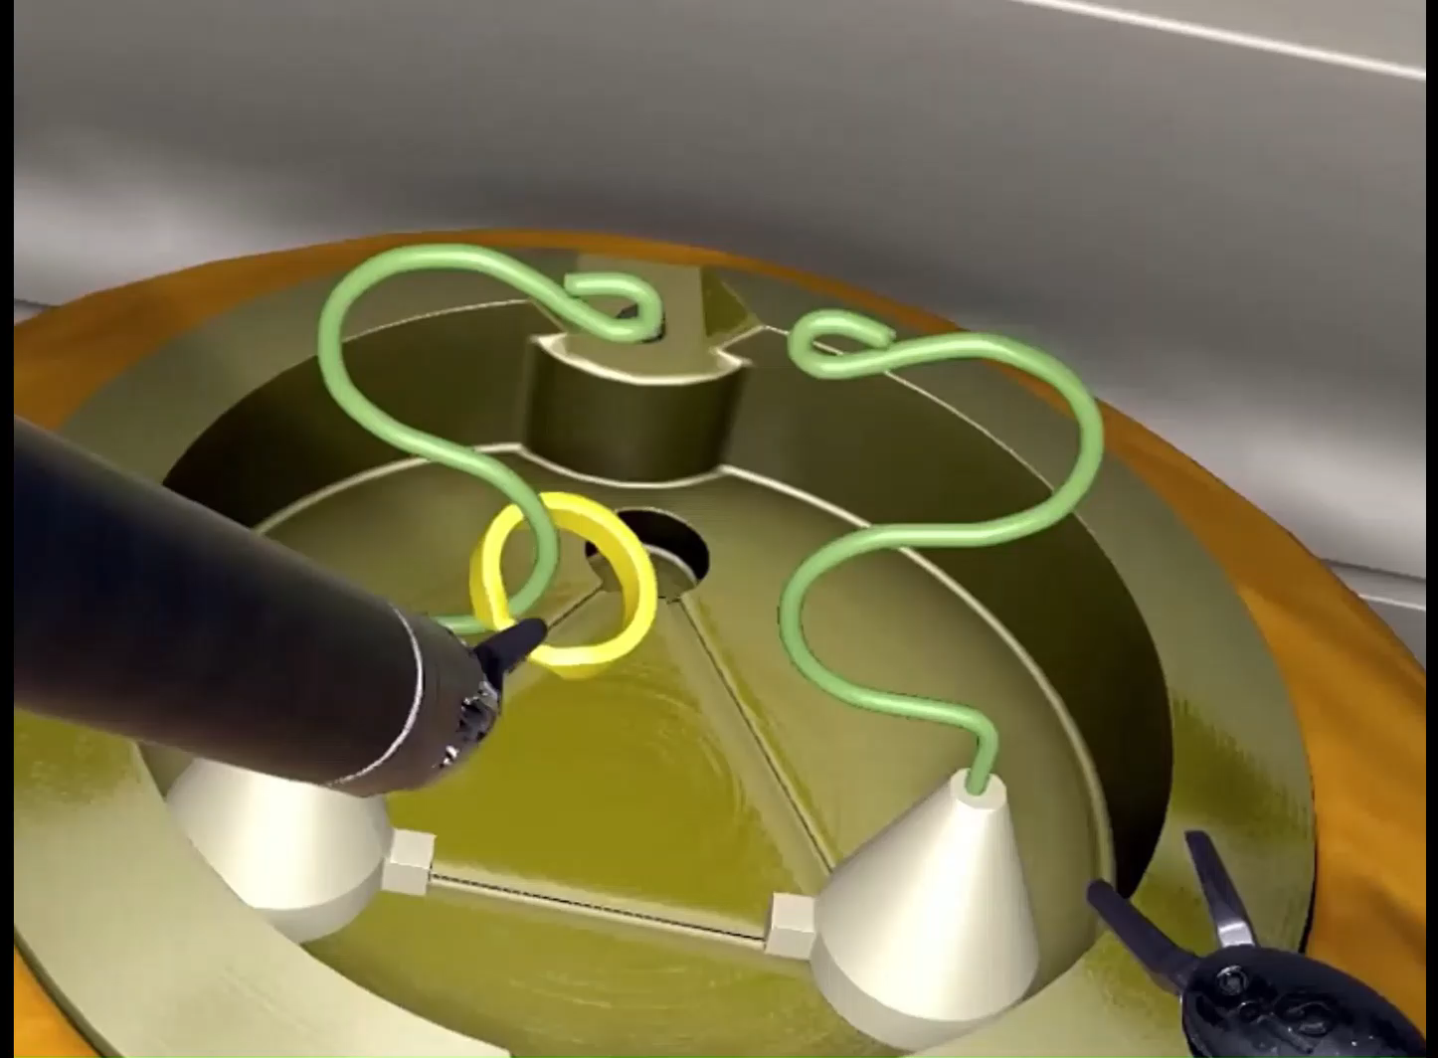
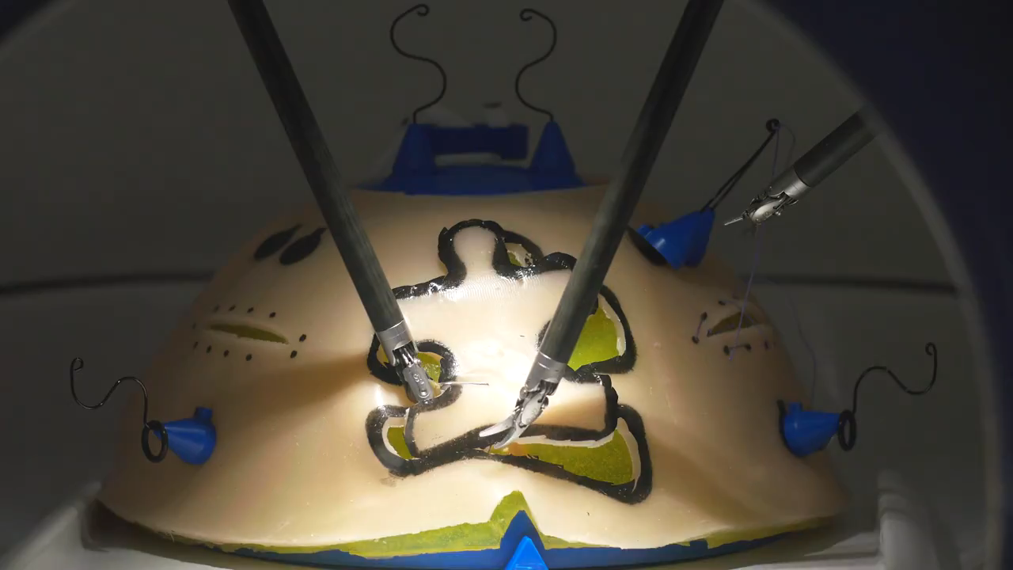





Introduction
State of the Art
Training Simulator
Experimental Phase
Results
Conclusions
Virtual Reality Simulators
Breadcrumbs
Before:
Dry-lab phantoms
Animal models
Nowadays:
Simulated Environments
Infinite repetitions
Customizability
Low costs
Progress tracking
Performance in VR simulators is correlated to clinical performance^{[2]}
© Intuitive Surgical Inc.
© Nicholson Center, Florida Hospital, FL
Slide Number
Citations in this style
2
_{[2] Aghazadeh et al. (2016)}

Slide 3
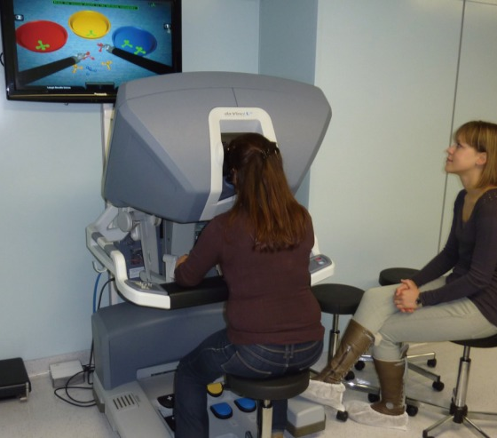
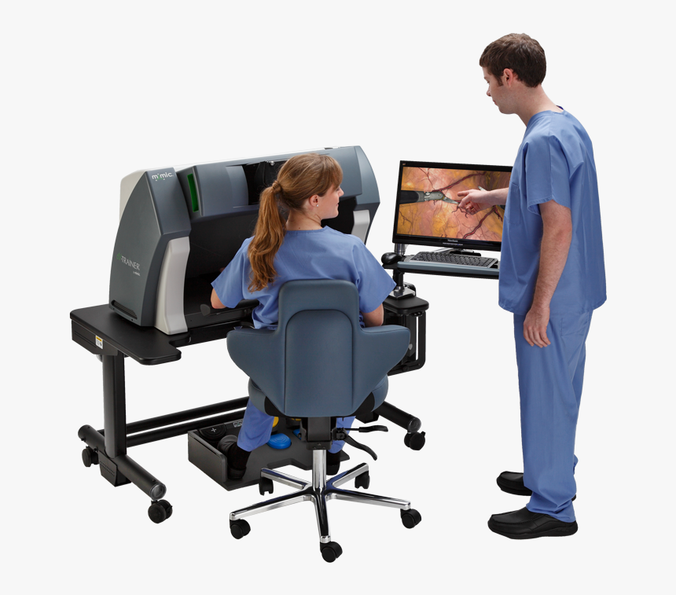
Introduction
State of the Art
Training Simulator
Experimental Phase
Results
Conclusions
State of the Art
Commercial Solutions: examples
daVinci SimNow – Intuitive Inc.
Mimic dV-Trainer: Mimic Inc.
© Intuitive Surgical Inc.
© Mimic Simulators Inc.
Copyright of all pictures downloaded from the web
3

Slide 4
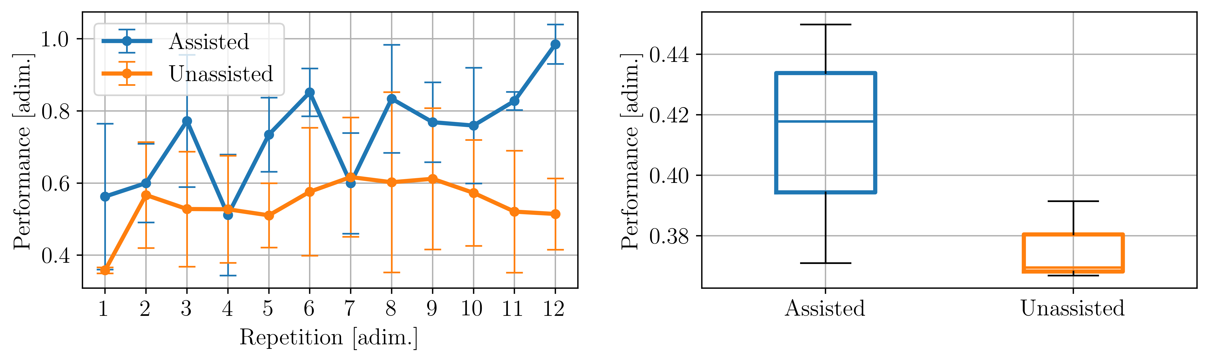
Introduction
State of the Art
Training Simulator
Experimental Phase
Results
Conclusions
Graphs labels and legends must be readable
Results
Consistent font between text and graphs (wherever possible)
Day 1
Day 2
Day 3
Day 4
Day 7
+13.07%
Units of measure ON ALL PLOTS
Assisted subjects execute tasks with a consistently better performance
Assisted subjects experienced an improved skill transfer towards non-assisted executions
13

